Slide 1
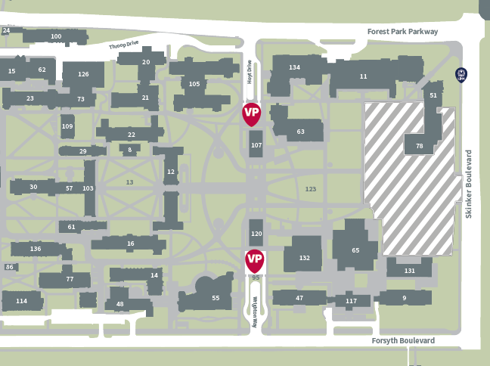
Instructions to Hillman Hall
MetroLink:
Hillman Hall is accessible via MetroLink light rail. The closest stop is the Skinker station (on the Blue Line), which is located at the northeast corner of Skinker Blvd. and Forest Park Parkway, approximately .5 miles from Hillman Hall. To plan your trip using MetroLink, visit: http://www.metrostlouis.org/
Lyft / Uber / Taxi:
Lyft and Uber service is available in the St. Louis region and there are multiple taxi services available, including: St. Louis County and Yellow Cab (314-656-6705) and Laclede Cab Company (314-652-3456).
Visitor Parking:
Guests to campus are encouraged to park in the East Campus Garage, which is equipped with gate-arm technology. Visitors will need to pull a ticket at the entrance to gain access and park in a designated visitor space. Please keep tickets on you and use the pay stations in the garage before leaving. Charges are incurred by the hour.
2017-2018 Visitor Garage Rates during 7am to 5pm business hours:
0-2 hours:$2.00
2-4 hours:$4:00
4-6 hours:$6.00
6-10 hours: $9.00
Lost ticket fee:$25.00
*Accepted forms of payment: cash (not accepted at west campus), debit, and major credit cards
ADA Drop Off Location
Visitor Parking
Hillman Event Entrance

