Slide 1
Academic Integrity
Stephen P. Ryan

Slide 2
Academic Integrity and Graduate School
You are here to produce knowledge
Goal is not to get good grades -> subject to passing, no one will ever care
This may require a shift in your perspective
Academia only works if there is trust
We’ll do a quick overview of the academic integrity policy for the Graduate School and highlight some areas you should keep in mind as you advance your career

Slide 3
Academic Policy of the Graduate School
All quotes from here: https://graduateschool.wustl.edu/sites/graduateschool.wustl.edu/files/Academic%20Integrity%20Policy%202018.pdf
“Academic integrity is of paramount importance at every educational institution. The university has an obligation to provide an atmosphere based on scrupulous adherence to the rules of honesty. This climate of impeccable integrity must encompass every aspect of academic activity. The university's role within the greater culture as provider of new knowledge and educator of future leaders demands no less. The integrity code governing all teachers, scholars, and researchers is severe. Even a single allegation of impropriety, unless refuted to the satisfaction of peers, can tarnish a reputation and block career development. An egregious violation could abruptly end a career in disgrace. Ignorance of the rules of academic conduct is normally not regarded as a mitigating factor.”
“Washington University promotes the highest standards in academic scholarship. The Graduate School, in providing a springboard for its students into careers in scholarship and research, does not tolerate any form of laxity in academic integrity. Term papers, seminar presentations, laboratory experiments, homework problems, and examinations, to say nothing of published work, conference papers, and theses or dissertations, must be regarded as training grounds not only in the acquisition of knowledge but in scholarly ethics. No instance of proven academic dishonesty can be ignored, even if the offender claims to be unaware that his or her actions constitute an offense.”
Takeaways:
Integrity is centrally important as nascent scholars
Violations are taken extremely seriously
Ignorance of violations is not an excuse

Slide 4
Areas of Potential Misconduct
Plagiarism
Cheating
Working together
Falsifying research

Slide 5
Plagiarism
Plagiarism is more than just copying someone else’s text without attribution
From the AIP: “Plagiarism is the willful or unintentional act of using, without proper acknowledgement, another person's or persons' words, ideas, results, methods, opinions, or concepts.”
“To avoid even the suspicion of plagiarism, a student must always:
Enclose every quotation in quotation marks, and acknowledge its source.
Cite the source of every summary, paraphrase, abstraction or adaptation of material originally prepared by another person, and any factual data that is not considered common knowledge. Include the name of author, title of work, publication information, and page reference.
Acknowledge material obtained from lectures, interviews, or other oral communication by citing the source (name of the speaker, the occasion, the place, and the date).
Cite material from the Internet as if it were from a traditionally published source. Follow the citation style or requirements of the instructor for whom the work is produced. Similar to standards governing preparation and publication of written works, there are standards that govern the creation and preparation of artistic, design and technical works and creations. It is a violation of academic integrity to represent another’s artistic, design or technical work or creation, including unacknowledged or unauthorized use of proofs and codes, as one’s own.”

Slide 6
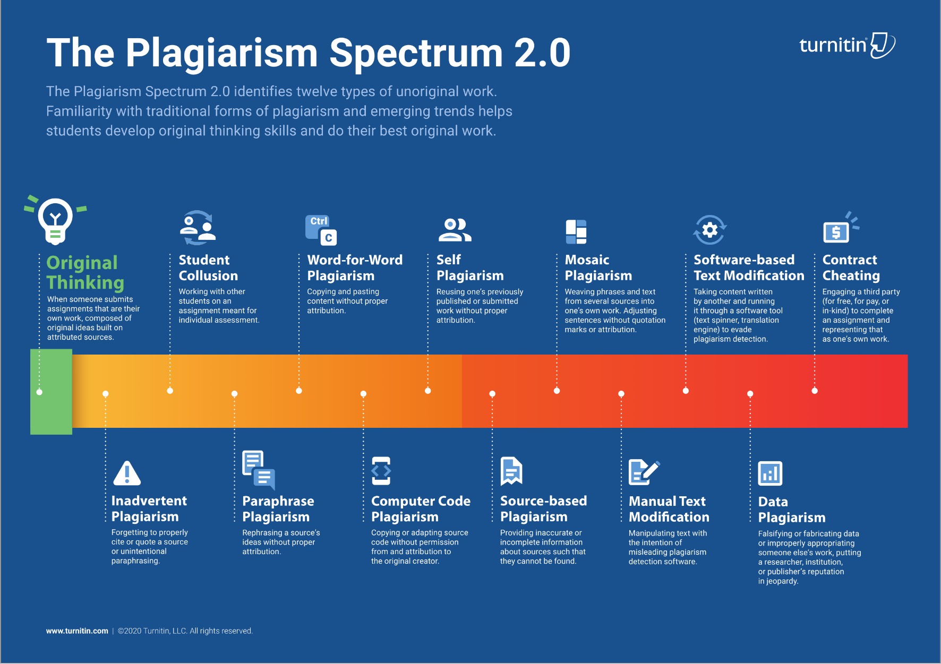
TurnItIn

Slide 7
Example
Paper summaries where students cut and pasted whole sections of the original paper in their answers
TurnItIn lit up like a Xmas tree

Slide 8
Working Together
You will often be encouraged to work collaboratively
It is paramount that you do not assume what your faculty deem acceptable cooperation
Some classes are a free-for-all, some group-based, most will be some mix of what is considered OK to work on together and what has to be your own work
Key takeaway: make sure that you are clear about faculty expectations before acting
If you work together, your work should have the name of everyone involved

Slide 9
So What Happens If You Mess Up?
From the AIP:
“The sole difference between the academic integrity code for graduate students and that for professionals is that student offenses are generally not publicly aired and that students may be permitted to continue their training if their transgressions are considered relatively minor or are considered to be adequately mitigated by circumstances. Findings of flagrant exhibitions of willful academic dishonesty, however, must result in expulsion from the Graduate School.”

