Slide 1
What is Web Accessibility?
WashU Web Accessibility Users Group
February 2019

Slide 2
What is ‘Accessibility’
The inclusive practice of removing barriers that prevent interaction with, or access to, websites by people with disabilities.
Web accessibility - Wikipedia

Slide 3
Assistive Technology
Any item, piece of equipment, or product system, whether acquired commercially off the shelf, modified or customized, that is used to increase, maintain or improve functional capabilities of individuals with disabilities.
Examples:
Screen Readers
Pointing devices
Switches
Alternate keyboards
Siri, Amazon Echo, etc.

Slide 4
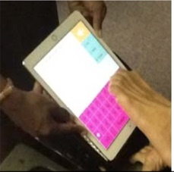
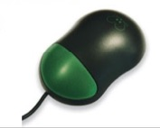
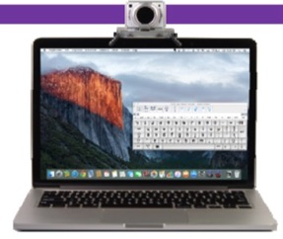
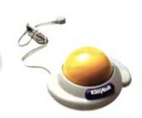
Alternate Access Methods
Alternate keyboards
Single button mice
Trackballs / Joysticks
Head pointing devices
Pointing / Typing aides
Head mice
Switches / Onscreen keyboards
Touch windows
Eye gaze

Slide 5
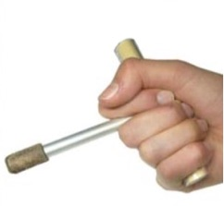
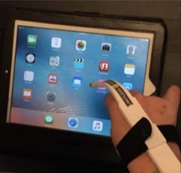
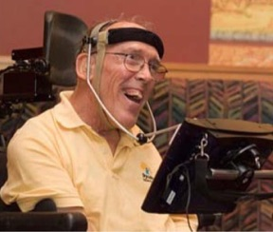
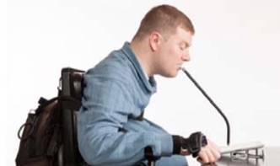
Low tech pointing devices can include:
Head / Chin pointers
Styluses
Adapted hand pointers
Mouth sticks

Slide 6
2010 U.S. Census: Nearly 1 in 5 have disability
About 56.7 million people, 19% of the population, had a disability in 2010, according to a broad definition of disability, with more than half of them reporting the disability was severe.
About 8.1 million people had vision difficulties, including two million who were blind or unable to see.
About 7.6 million people experienced difficulty hearing, including 1.1 million whose difficulty was severe. About 5.6 million used a hearing aid.
About 19.9 million people had difficulty lifting and grasping. This includes, for instance, trouble lifting an object like a bag of groceries, or grasping a glass or a pencil.

Slide 7
Web Content Accessibility Guidelines (WCAG) 2.1
(WCAG) 2.1 defines how to make Web content more accessible to people with disabilities. Accessibility involves a wide range of disabilities, including visual, auditory, physical, speech, cognitive, language, learning, and neurological disabilities. Although these guidelines cover a wide range of issues, they are not able to address the needs of people with all types, degrees, and combinations of disability. These guidelines also make Web content more usable by older individuals with changing abilities due to aging and often improve usability for users in general.
Web Content Accessibility Guidelines (WCAG) 2.1

Slide 8
WCAG 2.1
Pronounced “wuh cag”
The four guiding principles of accessibility in WCAG 2.1:
Perceivable
Operable
Understandable
Robust
Three levels of conformance: A, AA, AAA

Slide 9
Section 508
Applies to the federal government
Adopted as part of the 2001 Amendment to the Rehabilitation Act
Initially based on WCAG 1.0 (May 1999), updated to more align with WCAG 2.0.
Section508.gov

Slide 10
WCAG History
1.0 (May 1999)
2.0 (December 2008)
2.1 (June 2018)
17 additional success criteria added to existing WCAG 2.0.
Implemented in 2018
Web Content Accessibility Guidelines (WCAG) 2.1

Slide 11
Spectrum of Disabilities
Visual
Auditory
Physical
Cognitive
Speech

Slide 12
Visual Disabilities
Low vision
Partial sight
Poor acuity
Tunnel vision
Clouded vision
Color blindness
Blindness

Slide 13
Examples of Good Practice for Visual Disabilities
Images & controls should have equivalent text alternatives
Text, images & page layouts can be resized without losing information.
Video content has text or audio alternatives, or audio-description track.
Text and images have sufficient contrast between foreground and background color.
Provide consistent, predictable navigation.
Avoid using color alone to identify links or controls.

Slide 14
Auditory Disabilities
Hard of hearing
Deafness

Slide 15
Examples of good practice for auditory disabilities
Provide captions or transcripts for audio content, including videos.
Media players provide volume controls.
Media players provide options to adjust caption text size and colors.
No interactions that rely on using voice only.

Slide 16
Examples of Physical Disabilities
Amputation
Arthritis
Fibromyalgia
Rheumatism
Muscular dystrophy
Repetitive stress injury
Tremors and spasms
Quadriplegia

Slide 17
Good practice for physical disabilities
Provide full keyboard support
All links, menu items, controls accessible via keyboard (Tab, Shift+Tab, & Return keys)
No keyboard traps
Provide sufficient time to complete tasks.
Provide consistent, predictable, simple navigation and page functions.
Link targets, buttons should be of sufficient size.
Keyboard focus indicator is visible

Slide 18
Examples of cognitive disabilities
Attention deficit hyperactivity disorder (ADHD)
Autism spectrum disorder (ASD)
Memory impairments
Multiple sclerosis
Perceptual or learning disorders
Seizure disorders

Slide 19
Good practice for cognitive disorders
Provide simple navigation and page layouts that are easy to understand and use.
Avoid, when possible, complex sentences that are difficult to read or unusual words.
Avoid moving, blinking, or flickering content. Or provide method to disable.
Video, animations, or audio content can be paused or stopped.
Simple text is supplemented by images, graphs, or illustrations.

Slide 20
Accessibility > Compliance
Your site can be compliant, yet inaccessible.

Slide 21
UC Berkeley Removes Online lectures
In its review, the department looked at videos on UC-Berkeley’s YouTube page, finding that automatically generated captions weren’t complete or accurate, a barrier for those with hearing disabilities. Some videos also had issues that made them challenging for those with vision disabilities, such as low color contrast.
The department [DOJ] found that the university was in violation of the federal disabilities law because “significant portions of its online content are not provided in an accessible manner when necessary to ensure effective communication with individuals with hearing, vision or manual disabilities.”
Source – Why UC-Berkeley is restricting access to thousands of online lecture videos

Slide 22
Checking for Accessibility
Online Tools
WebAIM WAVE
Chrome and Firefox extensions
Manual Testing
Keyboard check
Use with screen reader

Slide 23
Don’t rely solely on web tools
Web tools like WebAim’s WAVE are one of the best way to check a site for accessibly but they won’t find all problems.
Keyboard Accessibility
Forms can be completed
Logical tab order
Visible focus indicator
Skip Link functionality
Alternative text supplied is in context.

Slide 24
Questions?

